Slide 1
Master Thesis Project: Bending-Twist Shape Adaptation of Wings by Compliant Chiral Spar Design
Alejandro Valverde López, Cranfield University
Advisors: Runkel, Falk; Keidel, Dominic; Urban Fasel

Slide 2
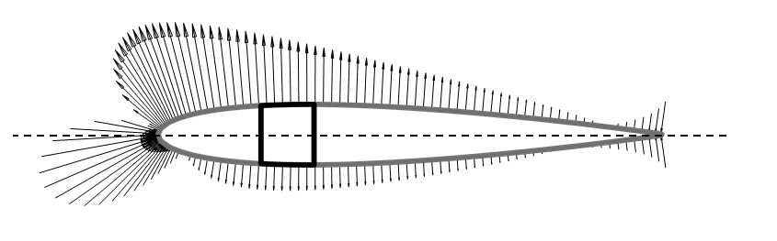

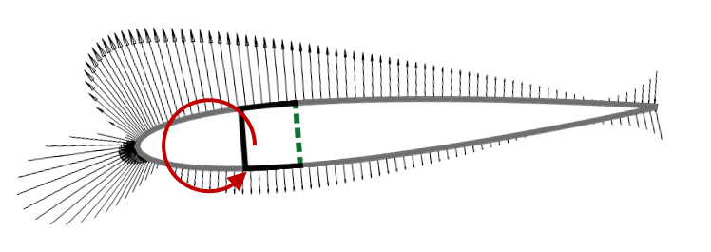
Motivation
Gust alleviation
Wing demonstrator
Raither(2013)

Slide 3
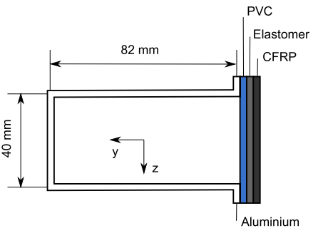
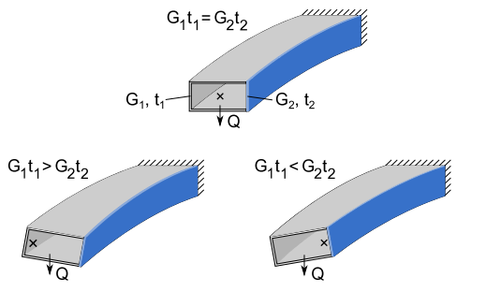
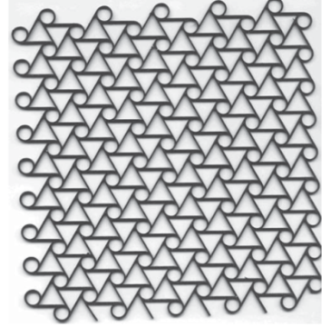
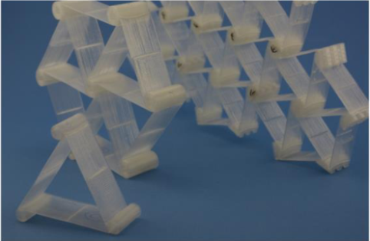
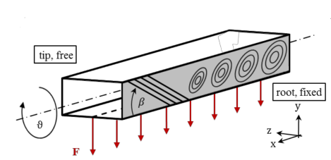
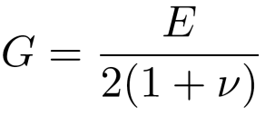
Different approaches
ΔT → G₂ t₂
Working principle, publicated on: Raither(2013)
Fig X: Working principle, Raither (2013)
Fig X: Time-variable lamination in laminate composite shells, Raither (2012)
Current project: Buckling-induced shear modulus variation
Runkel (2015): Δβ → material anisotropy
Fig X: Chiral structures in lattice
Fig X: Time-variable lamination in laminate composite shells, Raither (2012)
Notes:
Working principle
The variable shear stiffness G2t2 that is required for the activation of the adaptive web can in principle be achieved by changing either the web’s shear modulus or its thickness. The change in shear stiffness of the adaptive web will lead to a shift of the shear center in horizontal direction and thus to a non-zero twist of the profile.
Case 1-Raither:
An implementation based on the variation of the elastic modulus of a polymer web due to changes in temperature is investigated.
Case 2-Runkel:
A particular material anisotropy by varying fibre orientation and thickness of the component is introduced.
Case 3-Chiral:
At a particular external load, the shear flow in the web exceeds the buckling limit, resulting in a drastic reduction of the effective shear modulus of this structural element

Slide 4
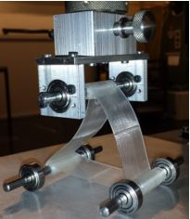
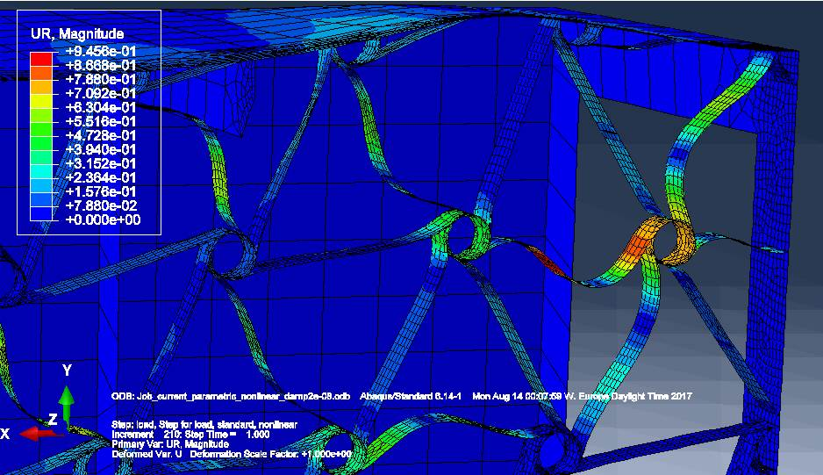
Working principle for the proposed technology
Elastic instabilities induced on the chiral elements ligaments
Reduction of the overall shear modulus G₂ for the lattice of chiral structures
Effectively an effective shear modulus G_{2,eff} is introduced
G_{2,eff} <G₁
Fig X: Set of chiral ligaments undergoing elastic instabilities at the root of the wing-box
Fig X: Compression load test on a basic triangular chiral structure

Slide 5
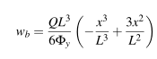
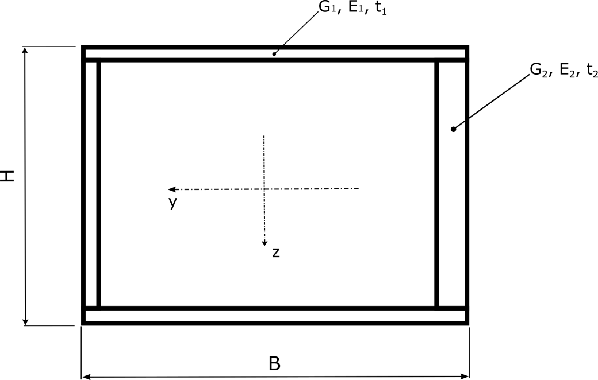
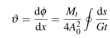
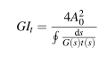
Analytical model
Used to provide fast insight of the role of each of the design parameters on the final mechanical properties of the beam
Bending deformation provided by Bernoulli-Euler equation:
Specific twist due to torsion provided by St. Venant equation:
Torsional stiffness:
Fig X: Analytical model of the closed section beam

Slide 6
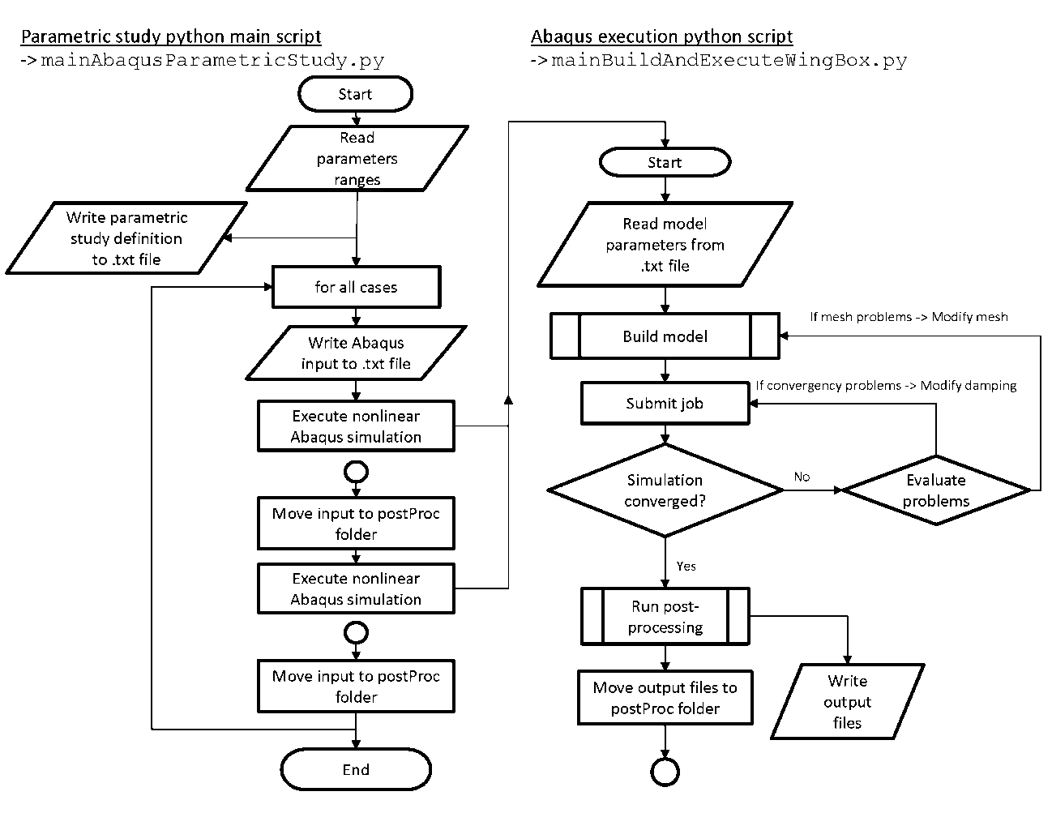
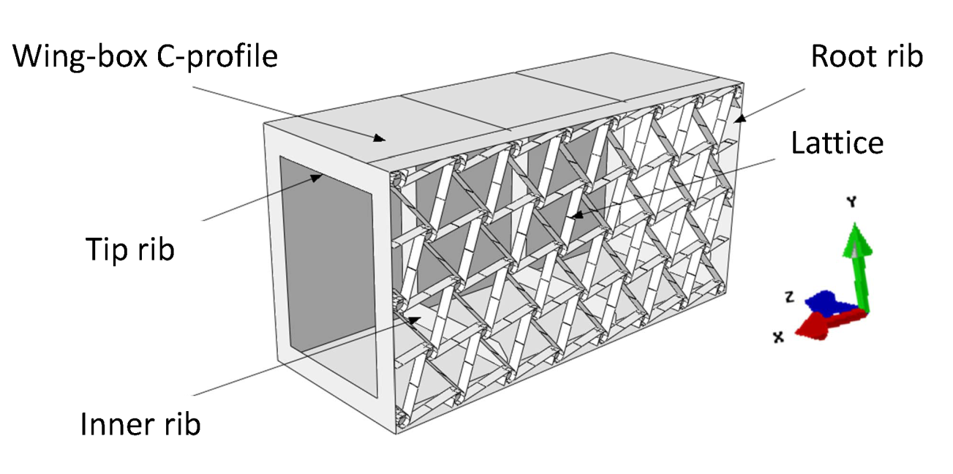
Computational model
The structure response was obtained executing nonlinear simulations on Abaqus CAE
Program using Python scripting
Fig X: General assembly of the computational model
Fig X: Flow chart showing the execution of the parametric study python code

Slide 7
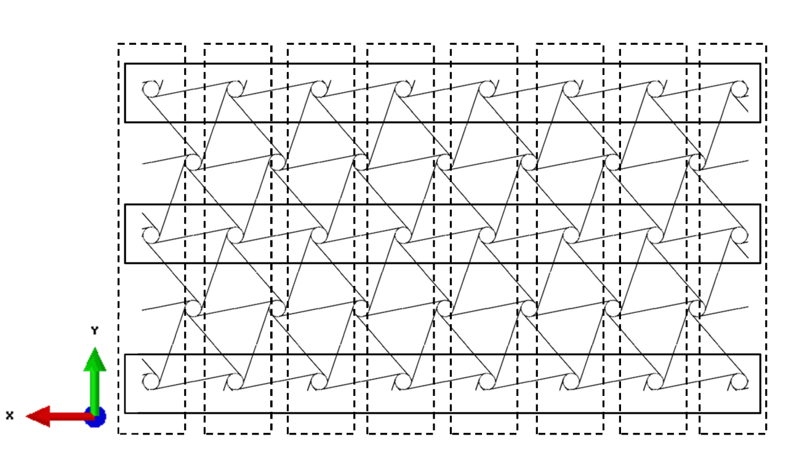
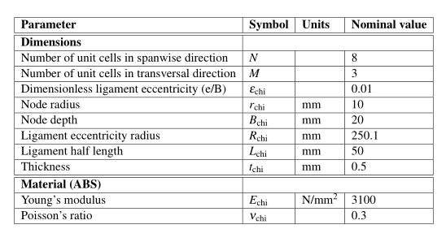
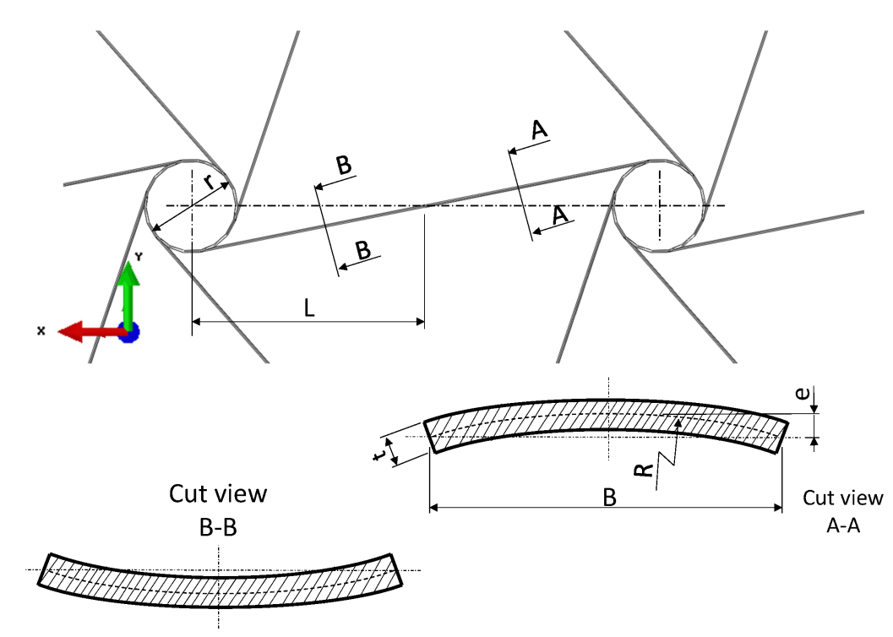
Computational model
Chiral structure description
Parameters used in the chiral structure lattice

Slide 8
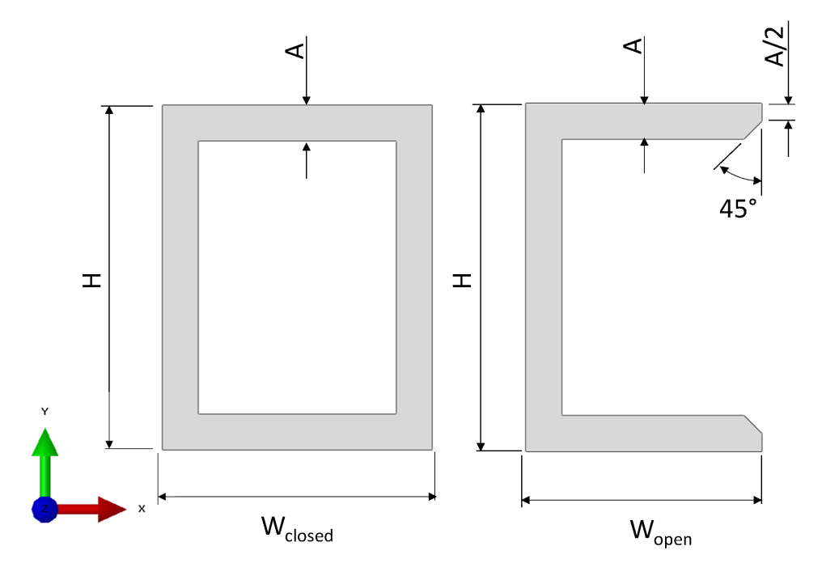
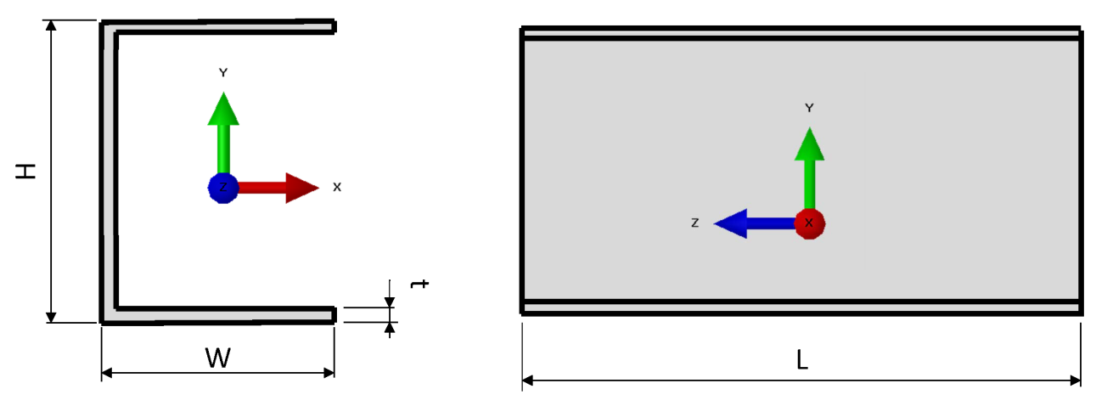
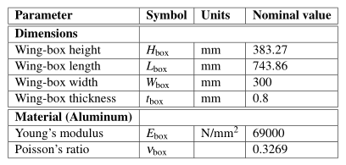
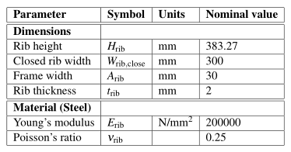
Computational model
Wing-box in C-profile and ribs
Parameters used in the wing-box in C-profile design
Parameters used in the ribs design

Slide 9

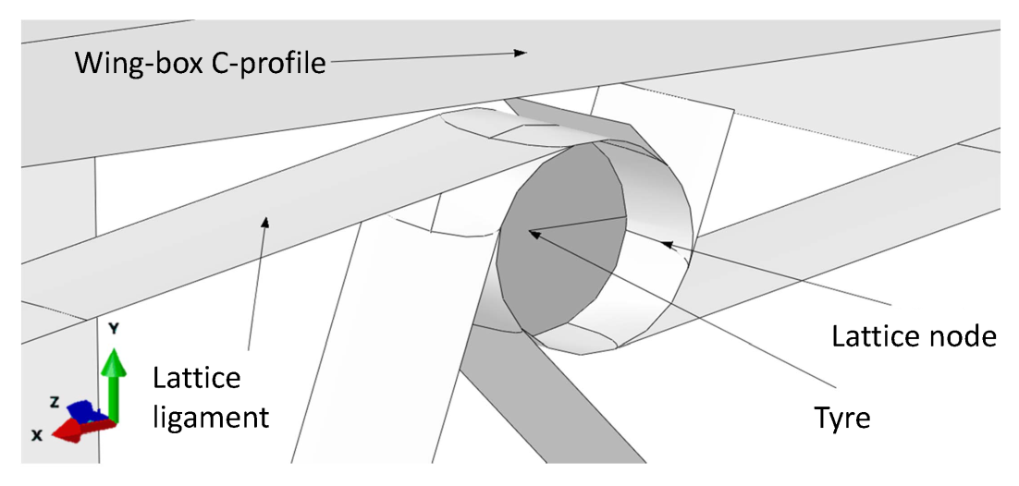
Computational model
Chiral lattice nodes rigid modeling
Lattice nodes are only constraint in rotation around its one axis by the lattice ligaments
In the modelling, they are assumed to behave like rigid bodies
Fig X: Tyre embedded into the lattice chiral node
Fig X: Chiral nodes on the manufactured demonstrator

Slide 10
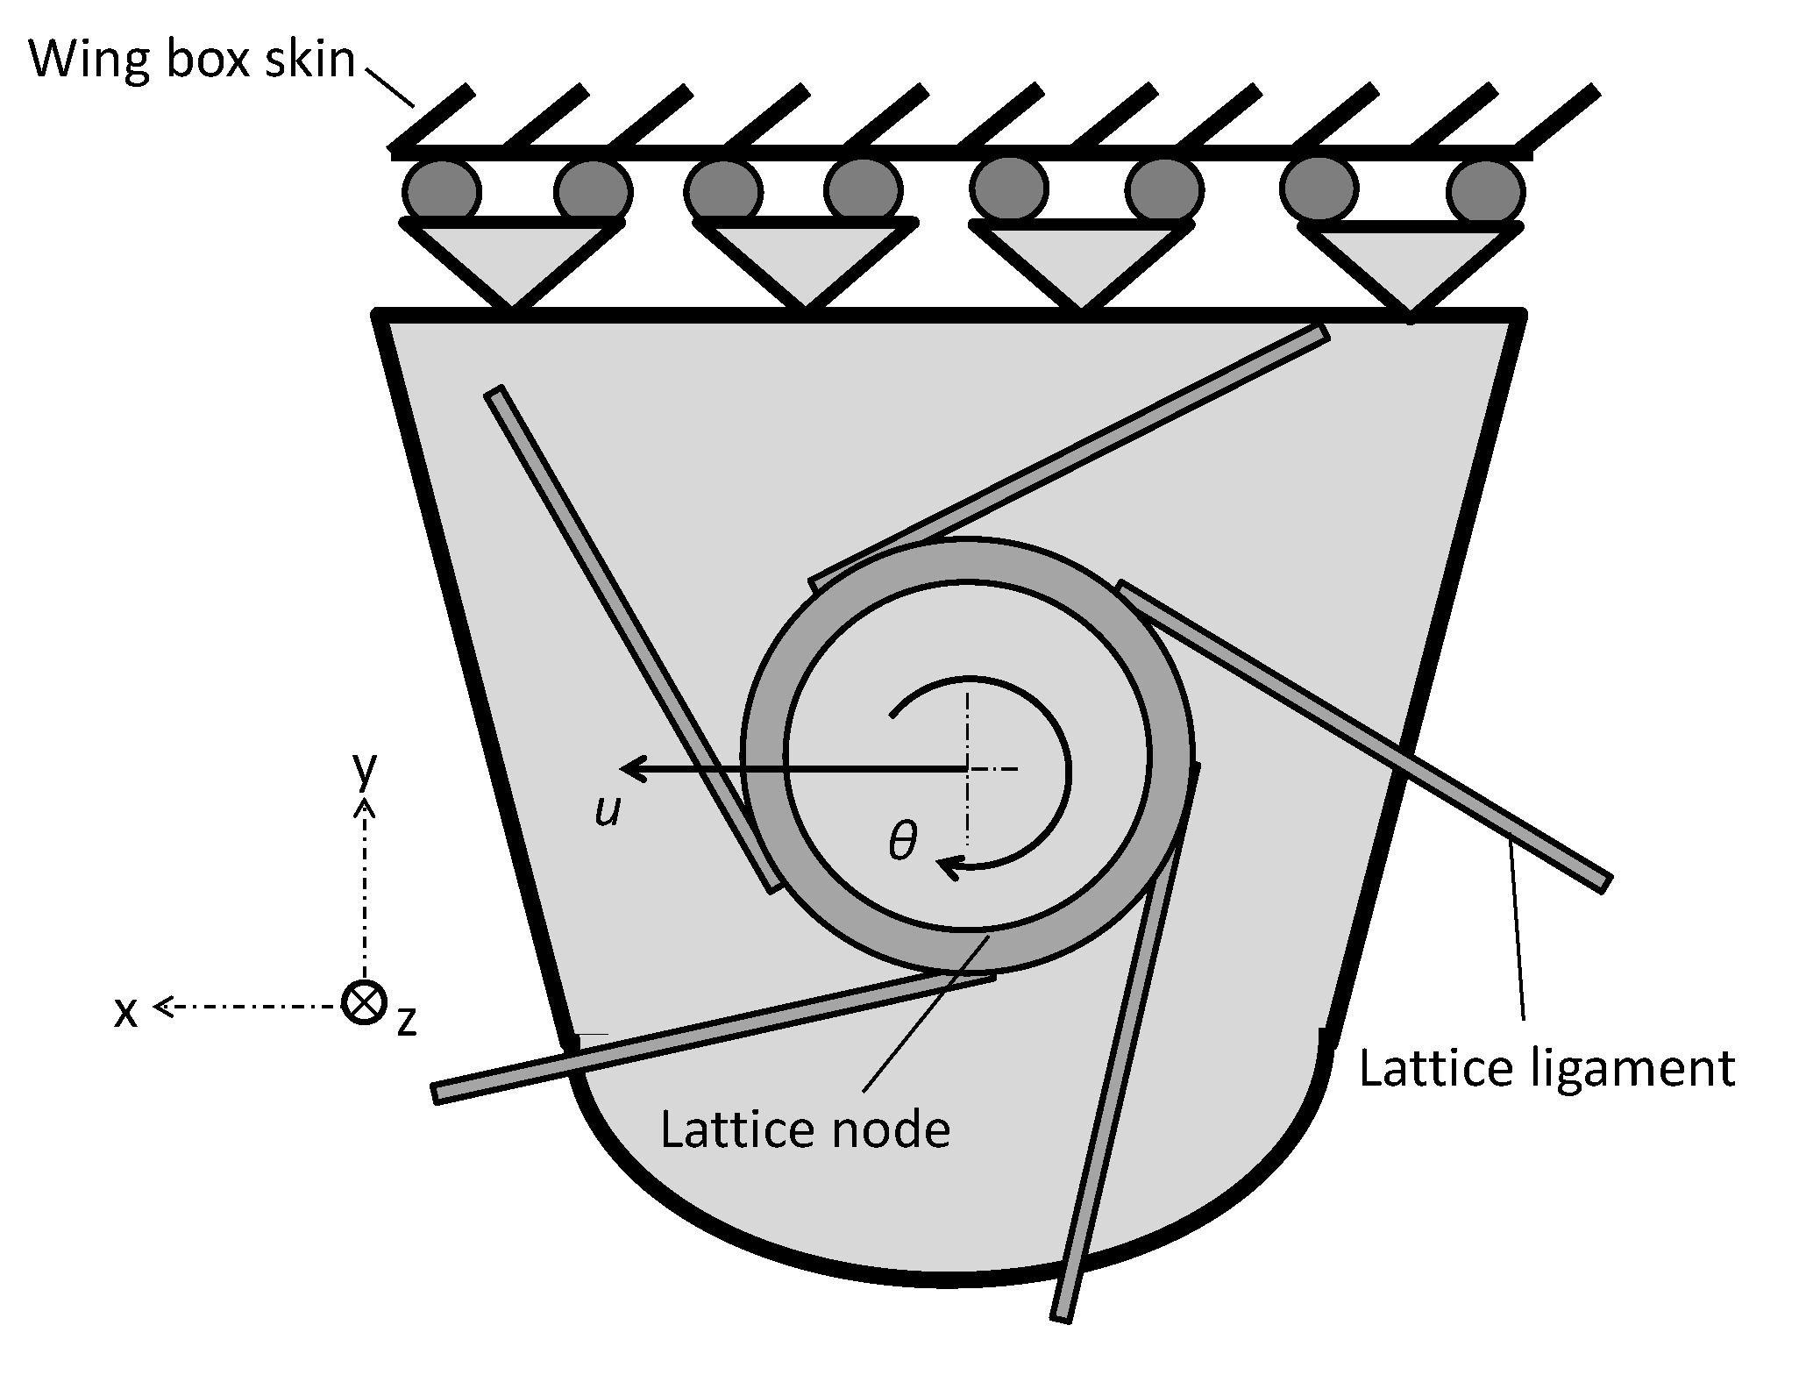
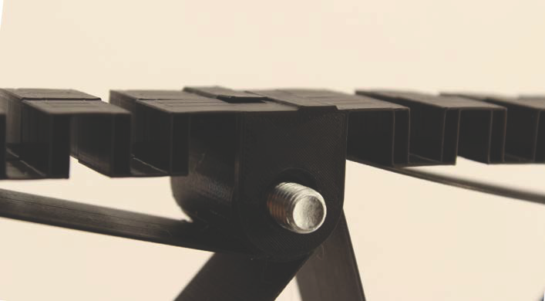
Computational model
Connection between the chiral lattice and wing-box skin
Unavoidable transition from the lattice of chiral structures comprised of nodes and ligaments to the skin of the wing-box
Loads are transmitted to the lattice through this attachment points that is why its design results crucial
Degrees of freedom unconstrained: u and θ
Fig X: Sketch of the connection between the chiral node
Fig X: Connection between the chiral lattice and the skin on the manufactured demonstrator

Slide 11
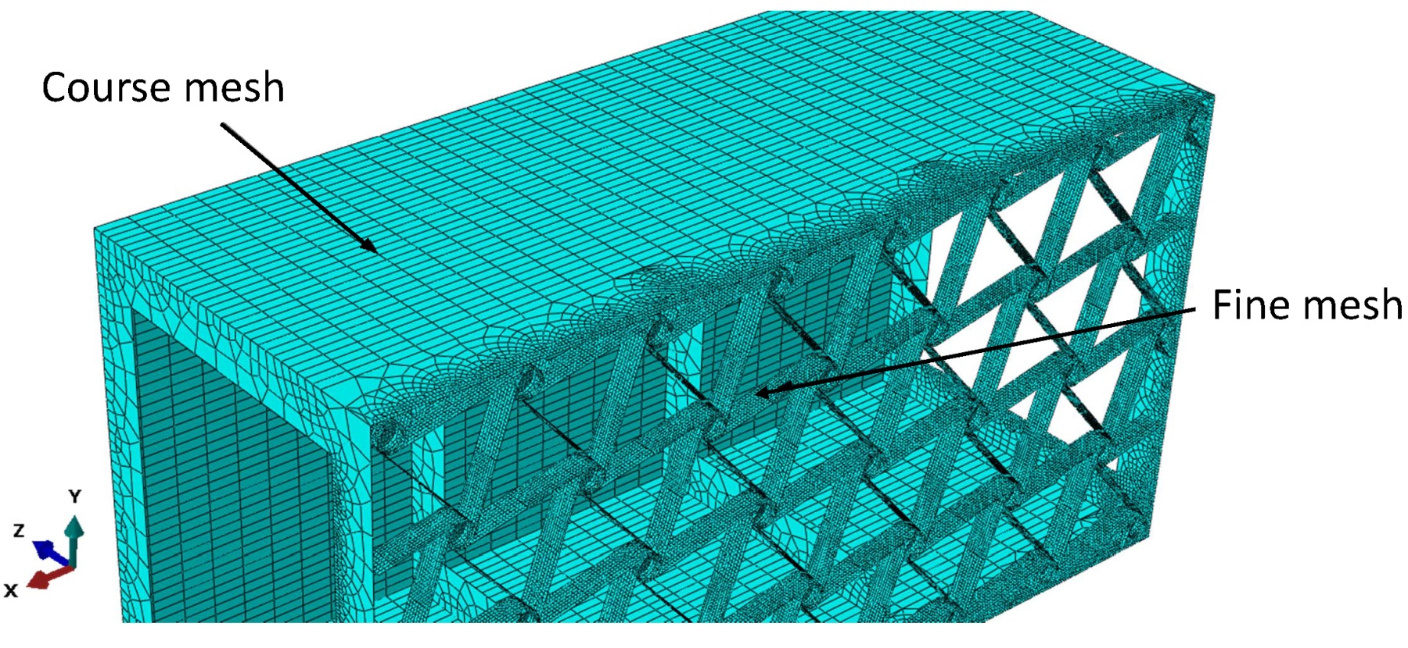
Computational model
Computational mesh description
Fine mesh size, typically equal to 3 mm.
Course mesh size, typically equal to 30 mm
Fig X:Different mesh regions

Slide 12
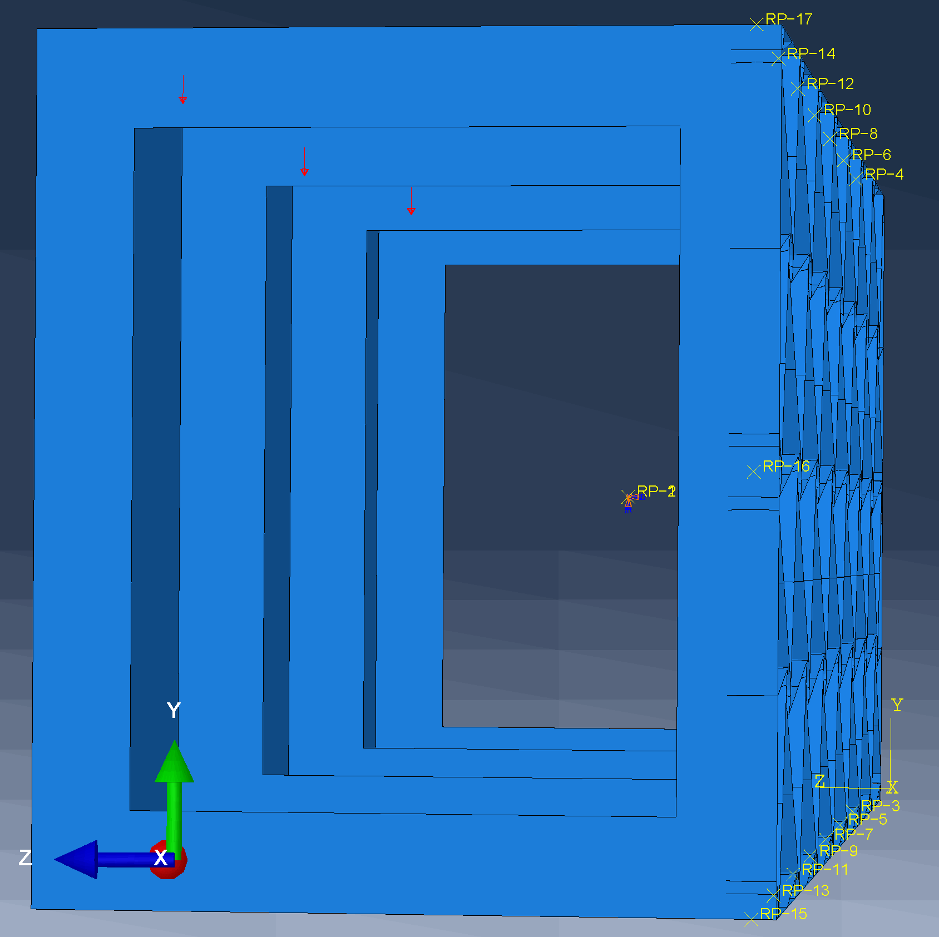
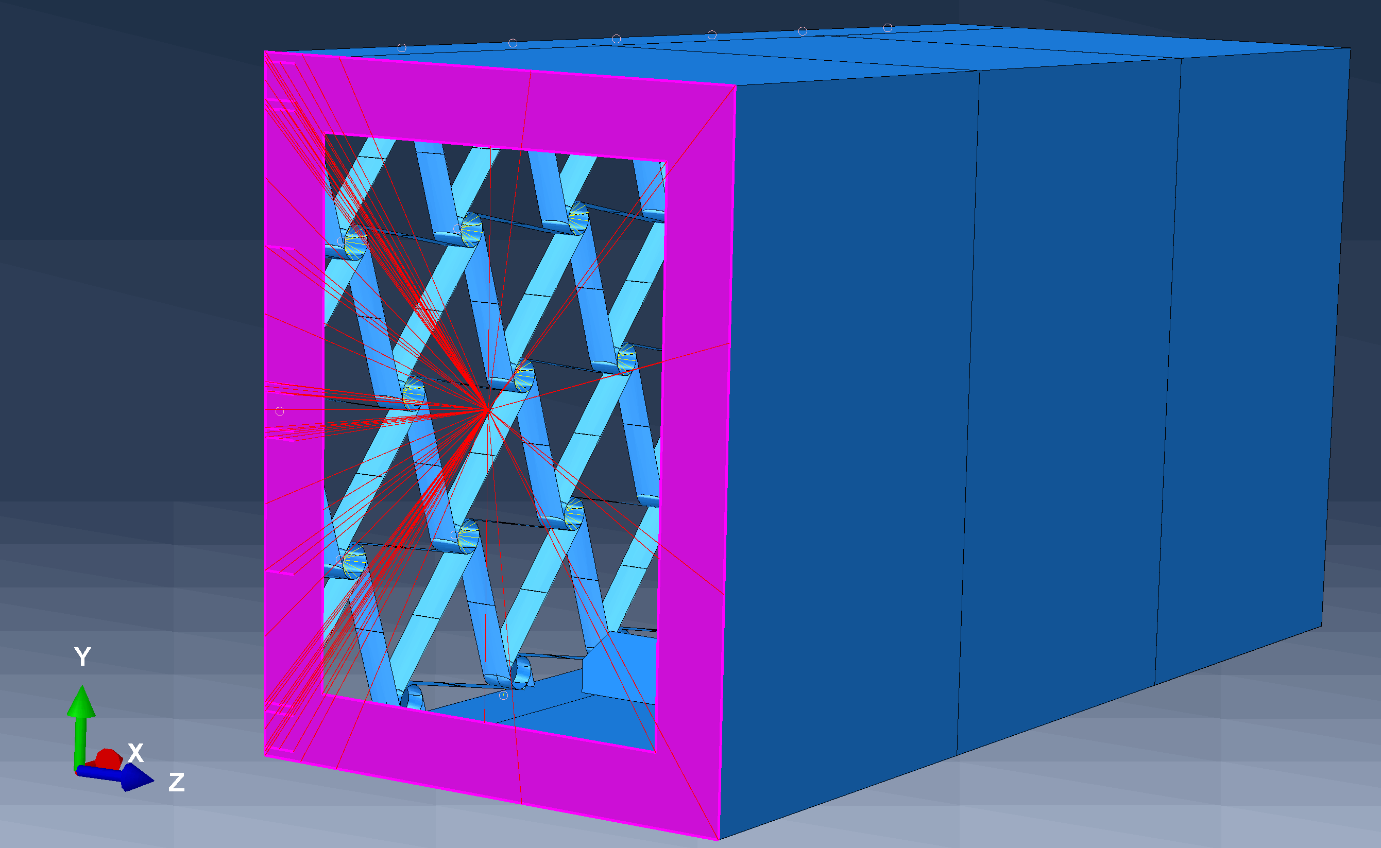
Computational model
Load introduction and boundary condition
Fig X: Fixed boundary condition
Fig X: Load introduction points

Slide 13
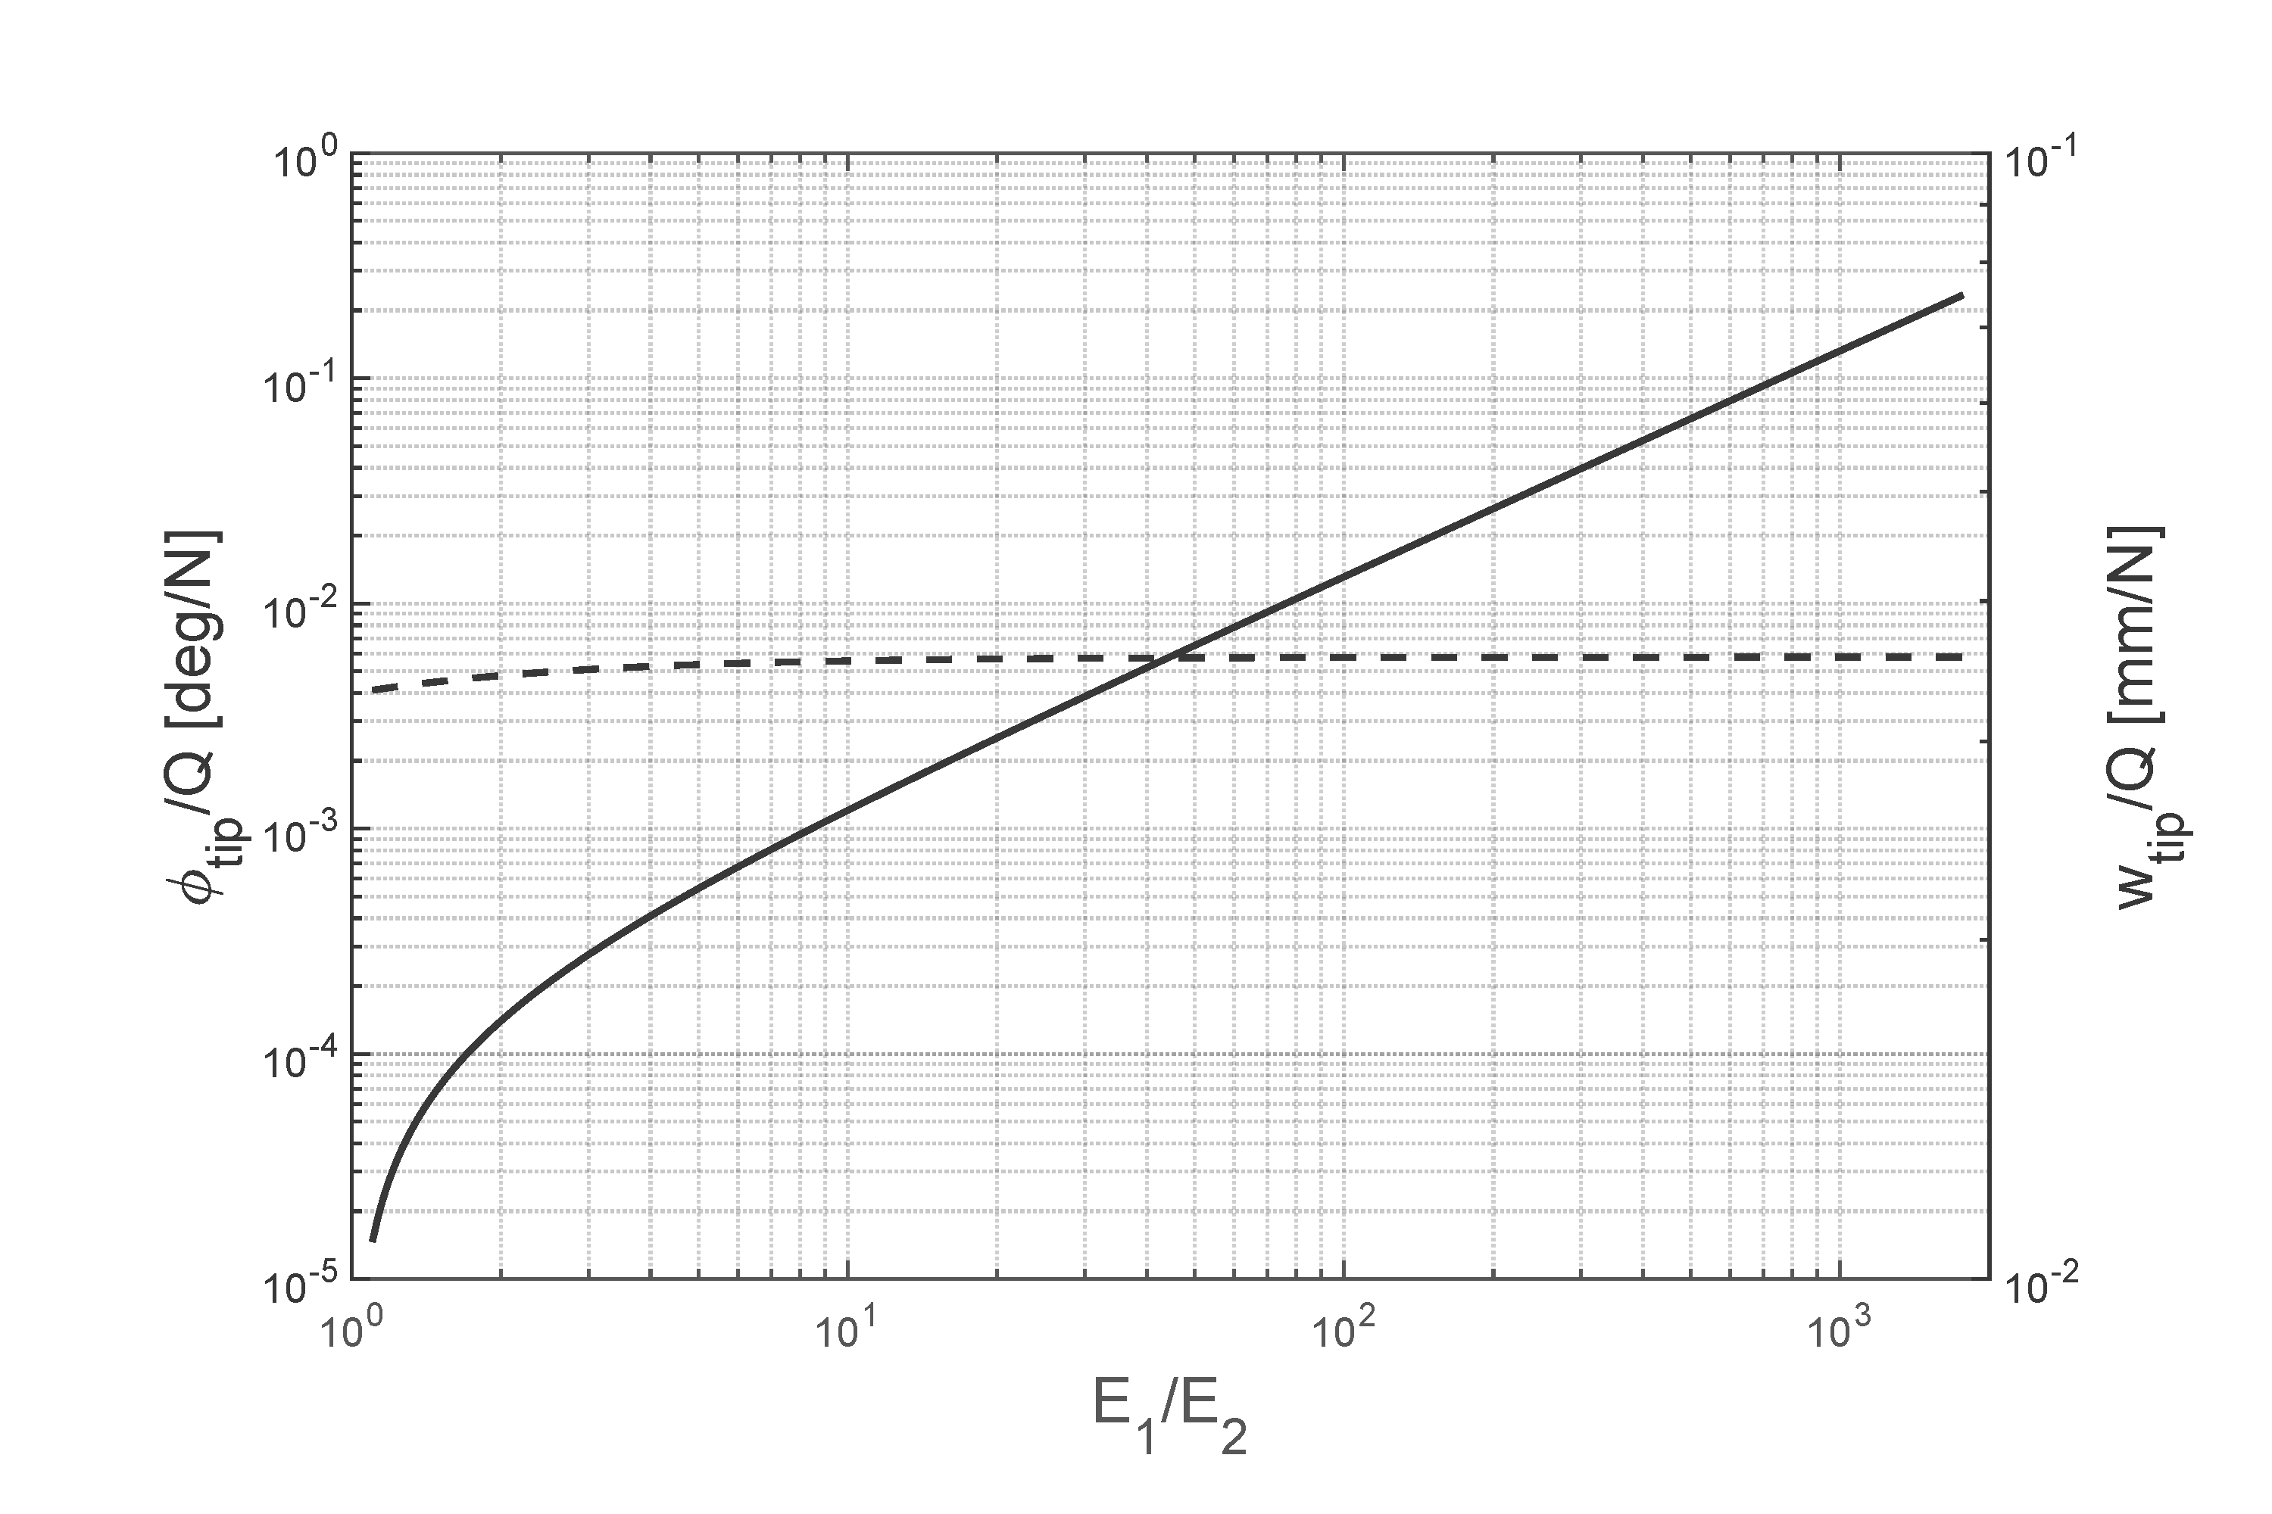
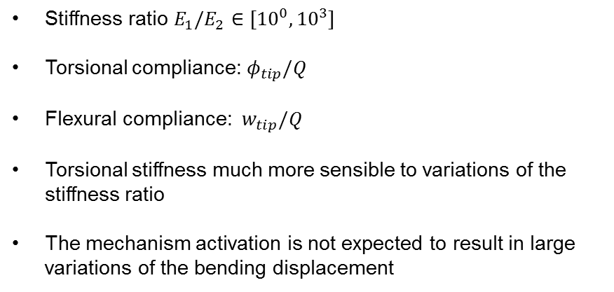
Results from the study on the analytical model
Preliminary results
Stiffness ratio $E_{1}/E_{2}$ $∈[{10}^{0}, {10}^{3}]$
Torsional compliance: $φ_{tip}/Q$
Flexural compliance: ${ w}_{tip}/Q$
Torsional stiffness much more sensible to variations of the stiffness ratio
The mechanism activation is not expected to result in large variations of the bending displacement
Fig X: Torsional and flexural compliances as a function of the stiffness ratio

Slide 14
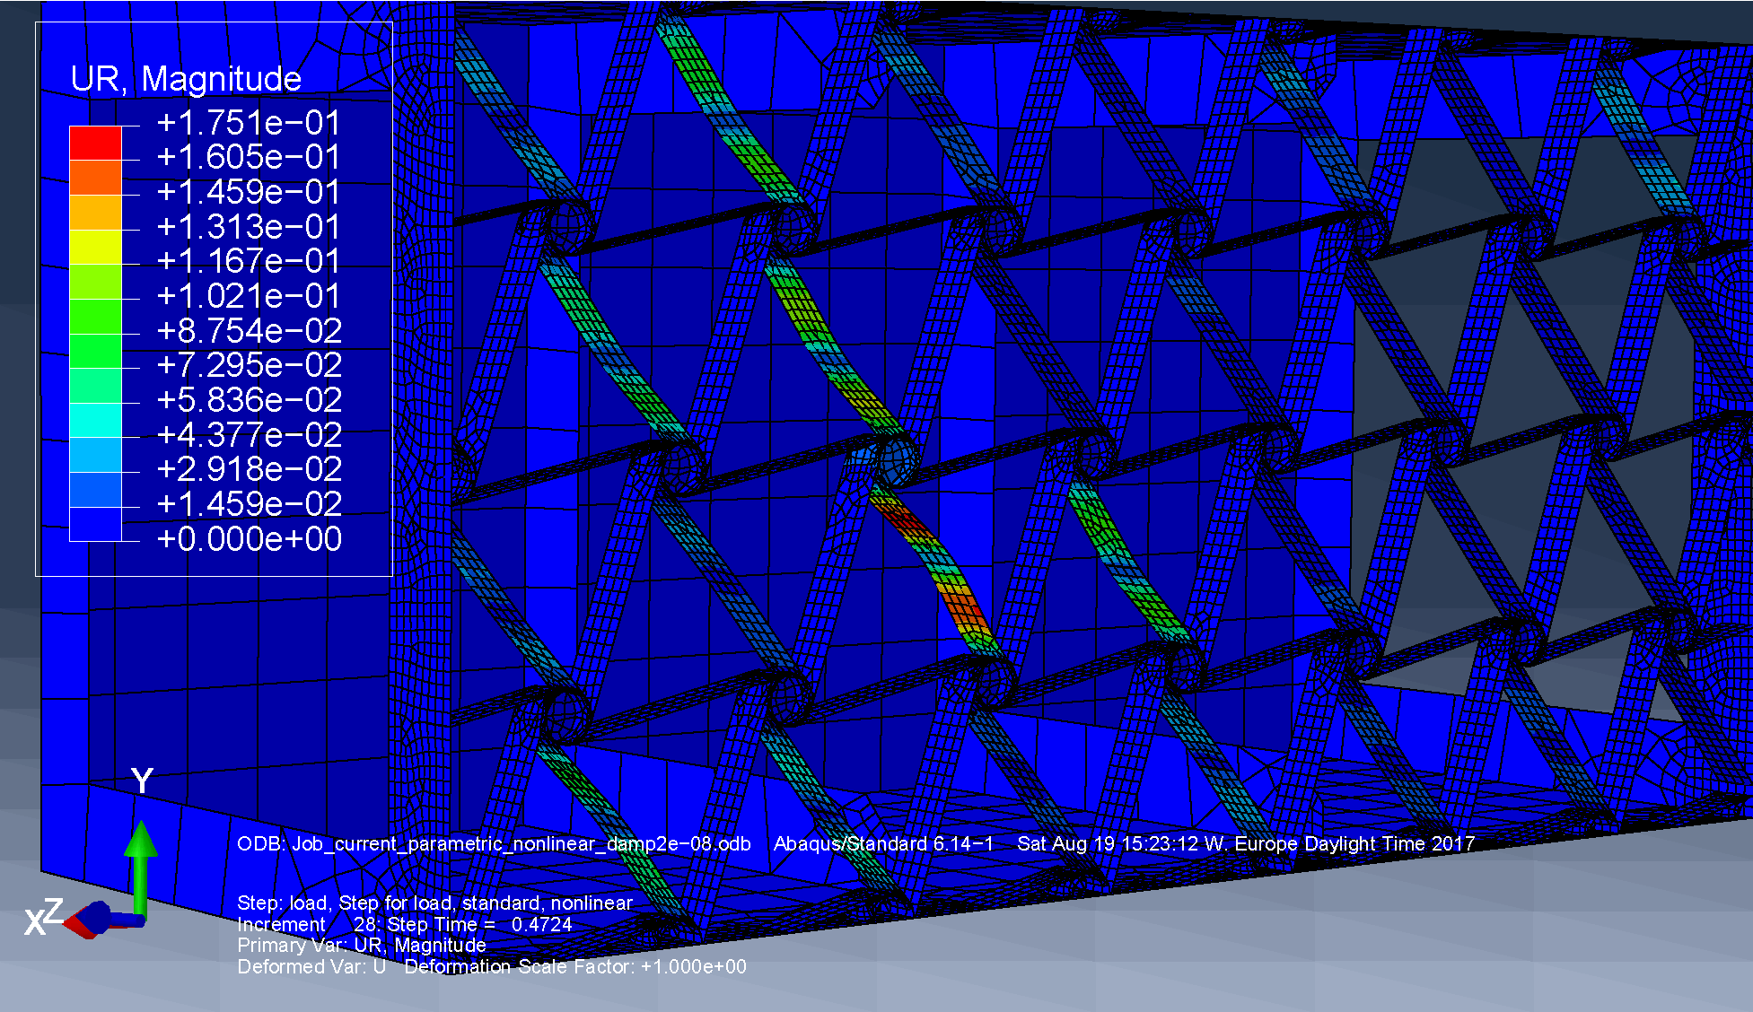
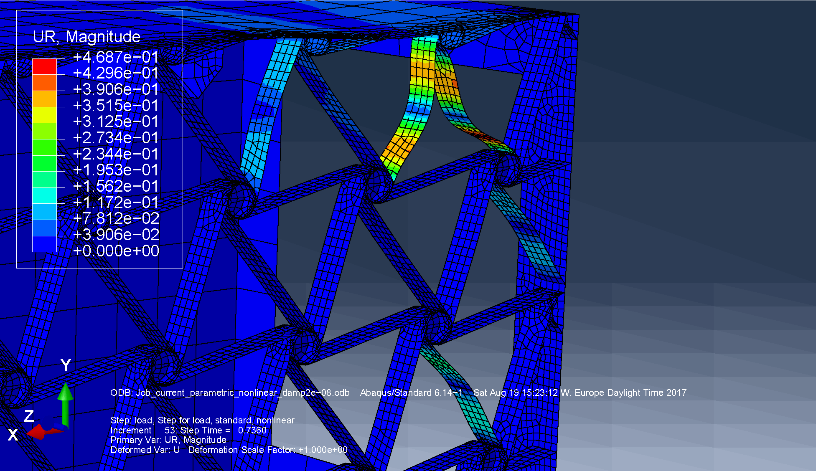
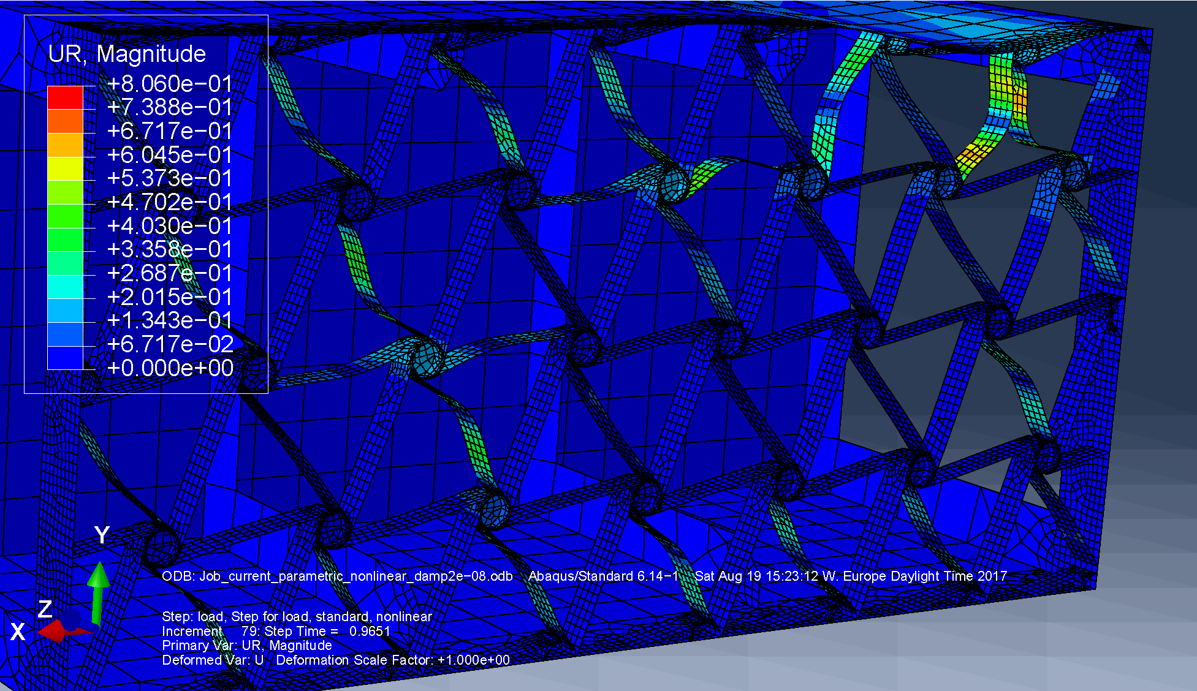
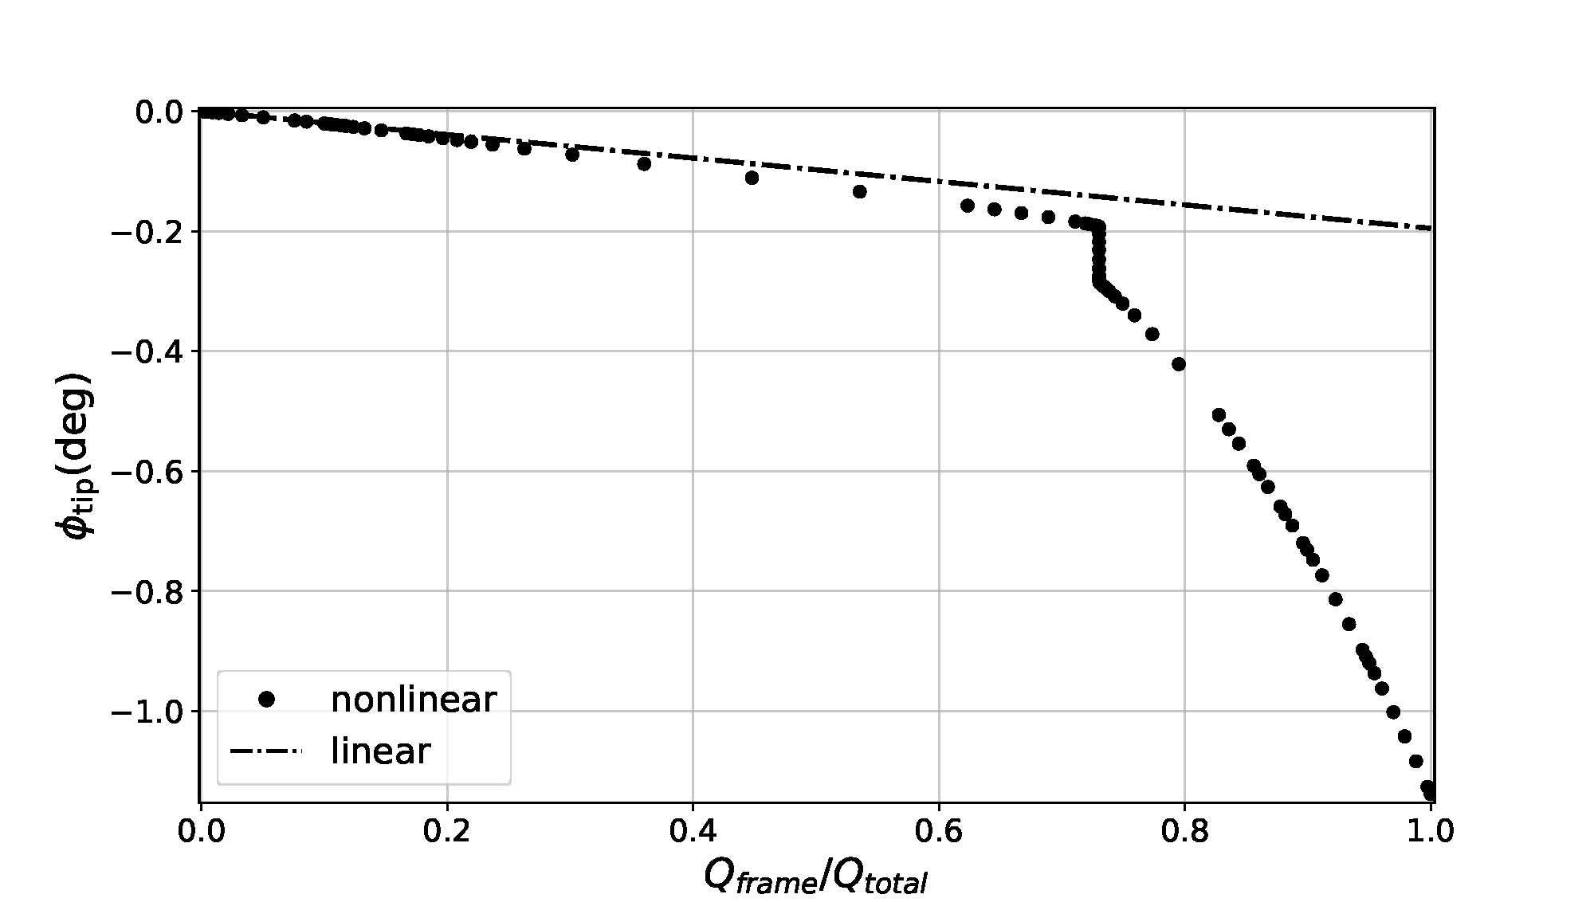
Computational model analysis
Response characterization
Fig X: 47% of the prescribed force applied
Fig X: 73% of the prescribed force applied
Fig X: 96% of the prescribed force applied
Fig X: Displacement-force curve

Slide 15
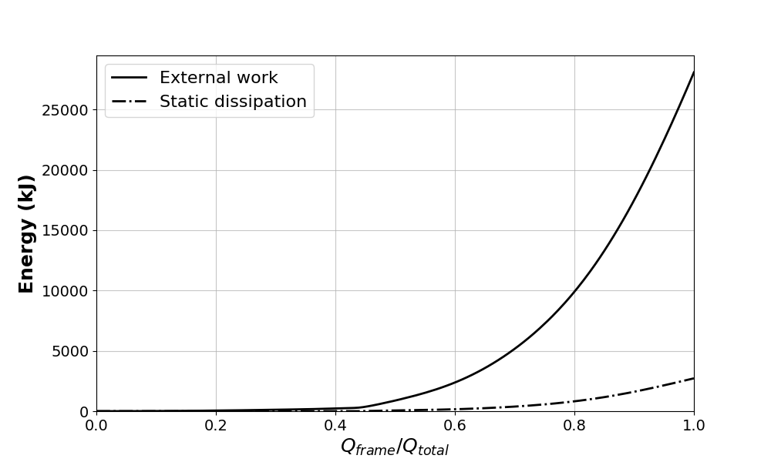
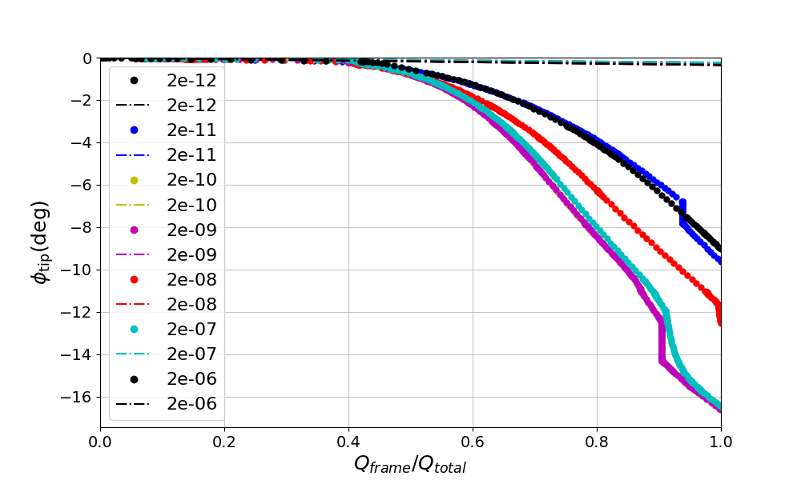
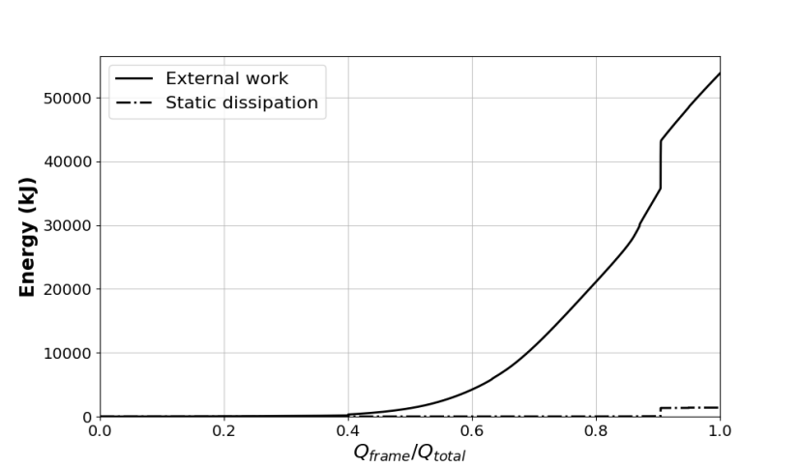
Computational model analysis
Artificial static energy dissipation using constant damping factor (c)
Fig X: For c = 10⁻⁶
Fig X: Displacement-force curve for various values of constant damping factor c
Fig X: For c = 10⁻⁹

Slide 16
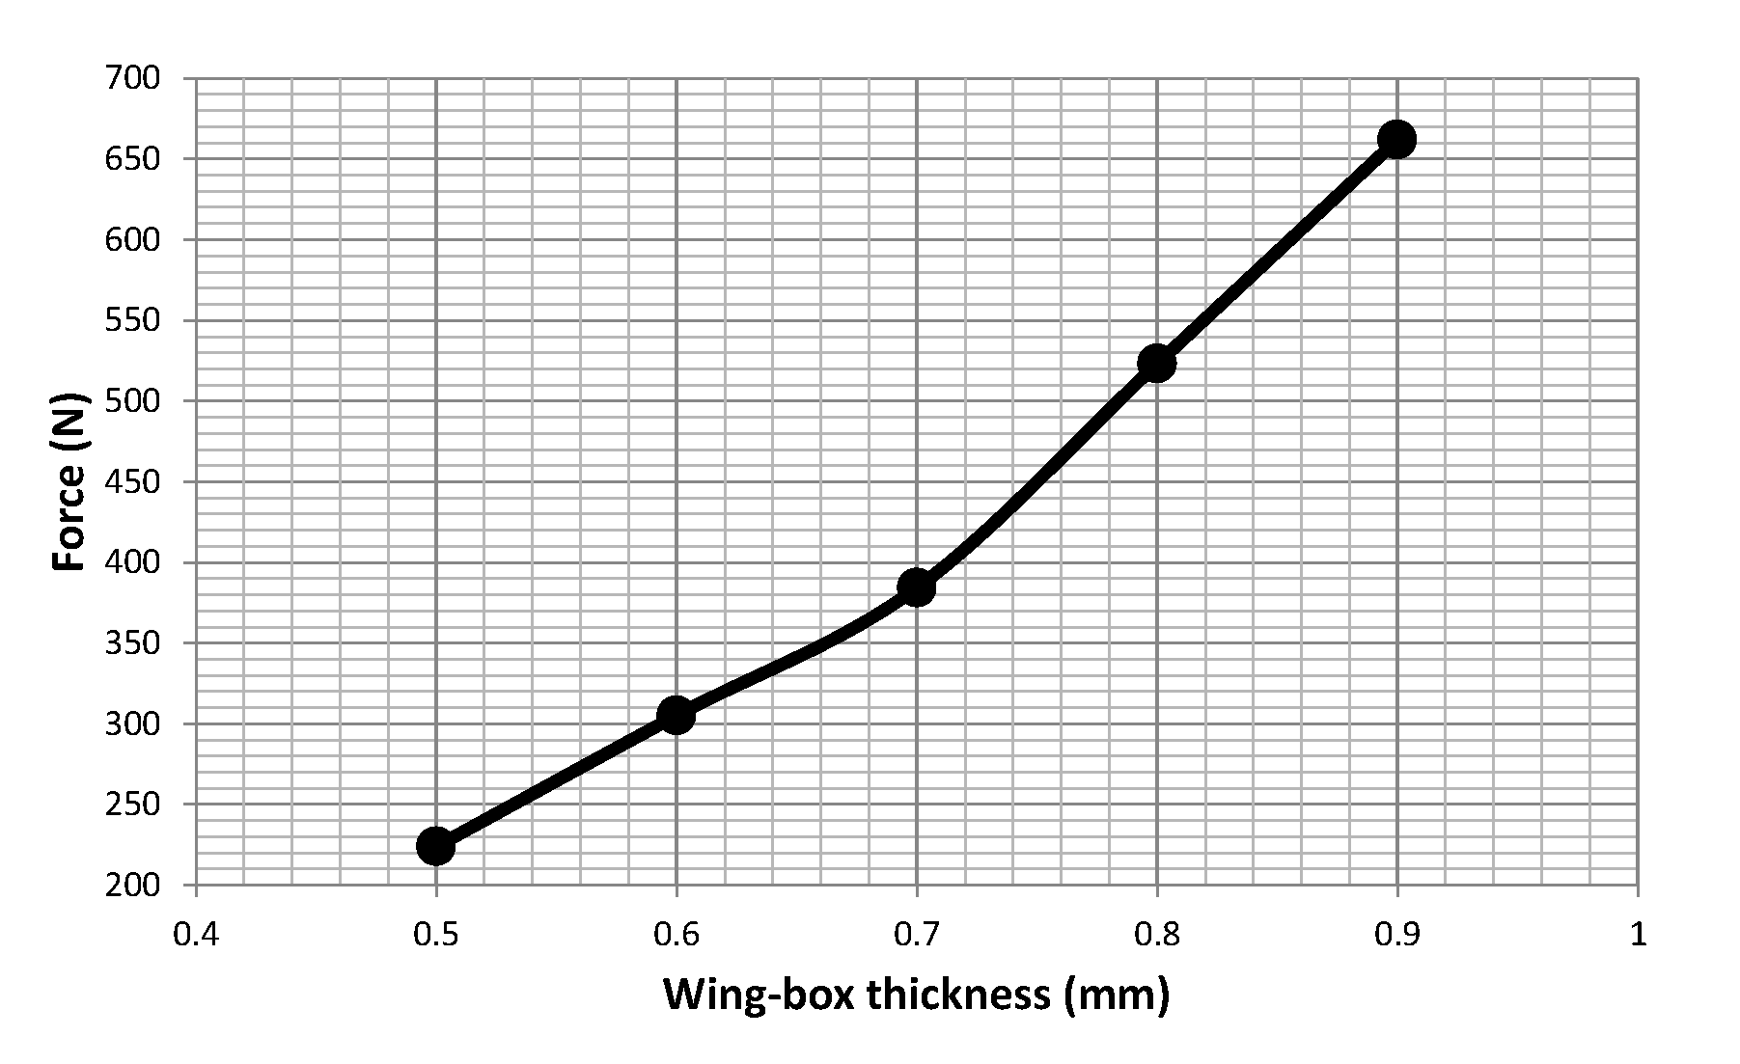
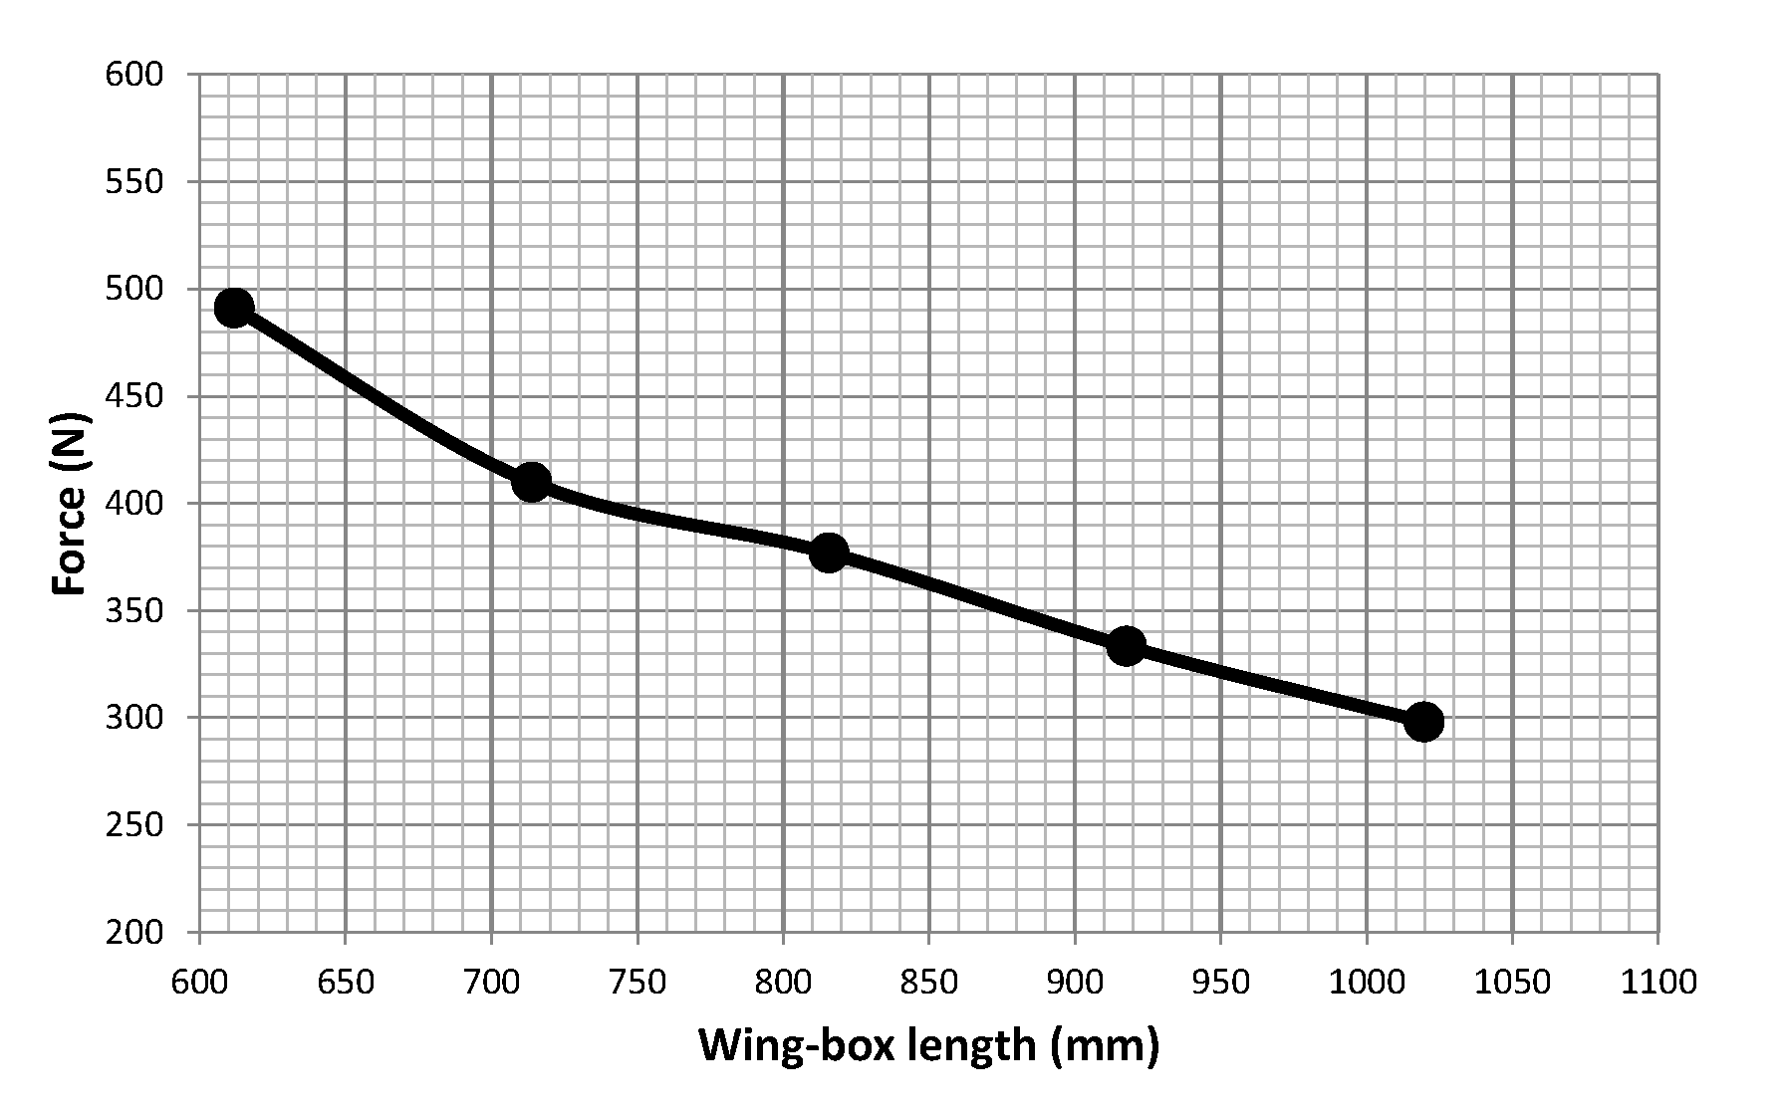
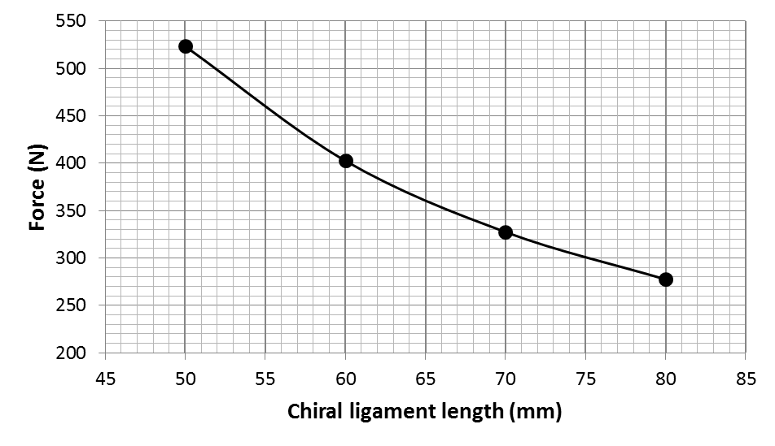
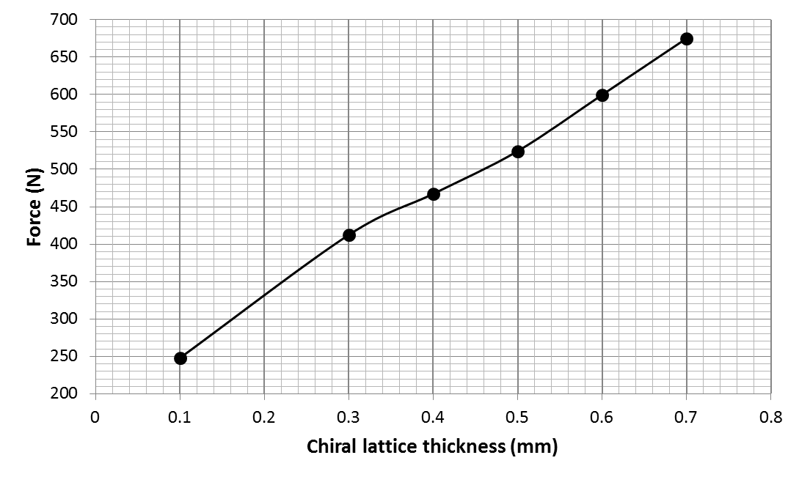
Computational model analysis
Buckling phenomena offset as function of design parameters
Fig X: Force that induces the structure to collapse as a function of the wing-box wall thickness
Fig X: Force that induces the structure to collapse as a function of the wing-box length
Fig X: Force that induces the structure to collapse as a function of the chiral ligament length
Fig X: Force that induces the structure to collapse as a function of the chiral lattice thickness

Slide 17
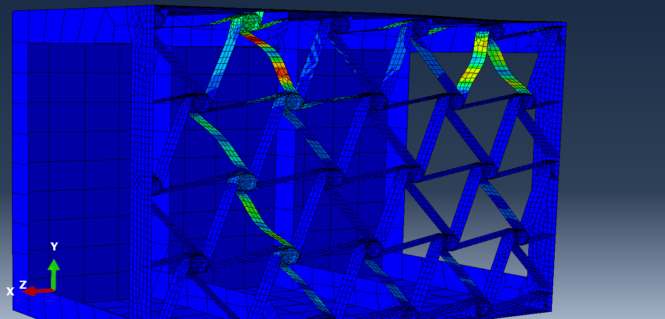
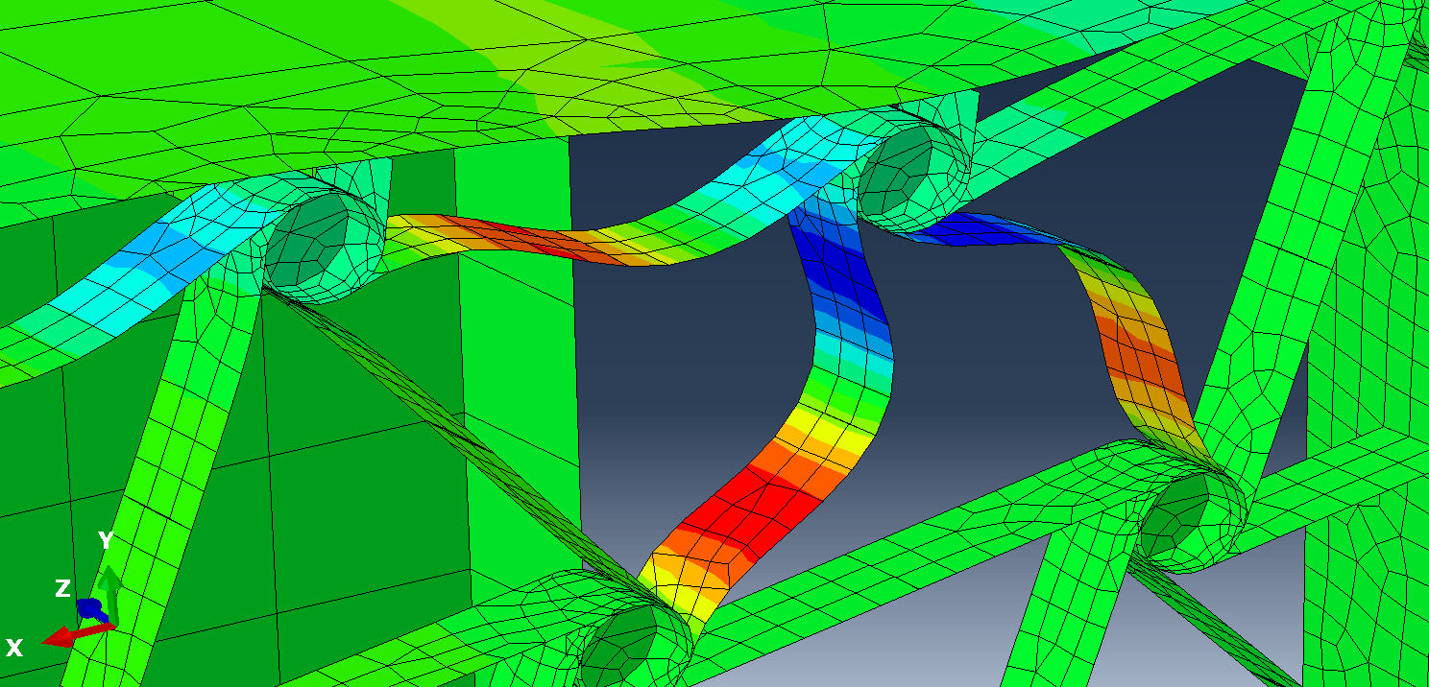
Computational model analysis
Model optimization
Two slides
Connection between the lattice nodes and the wing-box skin
Consistency analysis

Slide 18
Further steps
Implementation of the wing-box model into a wing model with aerodynamic loads
Report finalization – Most of it is already written

Slide 19
References
W. Raither, A. Bergamini, F. Gandhi, and P. Ermanni, “Adaptive bending-twist coupling in laminated composite plates by controllable shear stress transfer,” in Composites Part A: Applied Science and Manufacturing, vol. 43, pp. 1709–1716, 2012.
W. Raither, A. Bergamini, and P. Ermanni, “Profile beams with adaptive bending-twist coupling by adjustable shear centre location,” Journal of Intelligent Material Systems and Structures, vol. 24, no. 3, pp. 334–346, 2013.
G. Ramstein, Experimental Validation of Chiral Structures with Local Controlled Instabilities. Semester project no. 16-015, ETH Zürich, 2016.

